Slide 1
Discounts for the Future
By Marlen and Anish

Slide 2
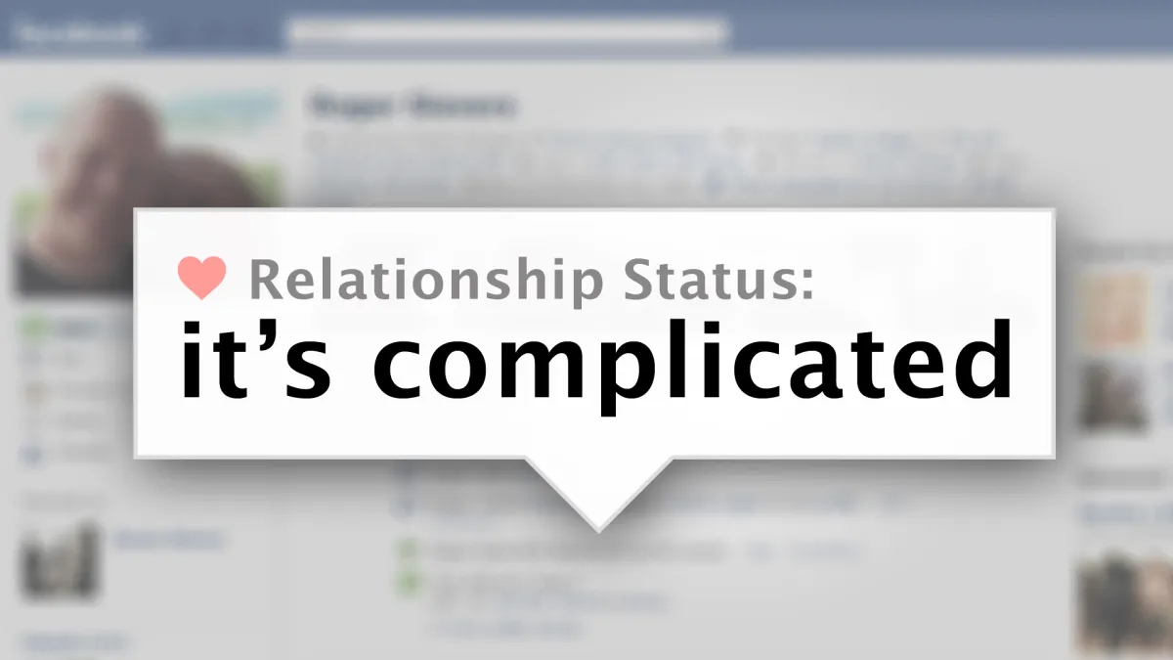
Eniac & Discounts Their Relationship
Eniac is a quality tech seller
Eniac imposes a lot of discounts
Their relationship depends fully on the time of year

Slide 3




Considerations for Analysis
Timeframe
15 Months
Number of Orders
45 Thousand
Revenue
15 Million
Order Status
Completed

Slide 4
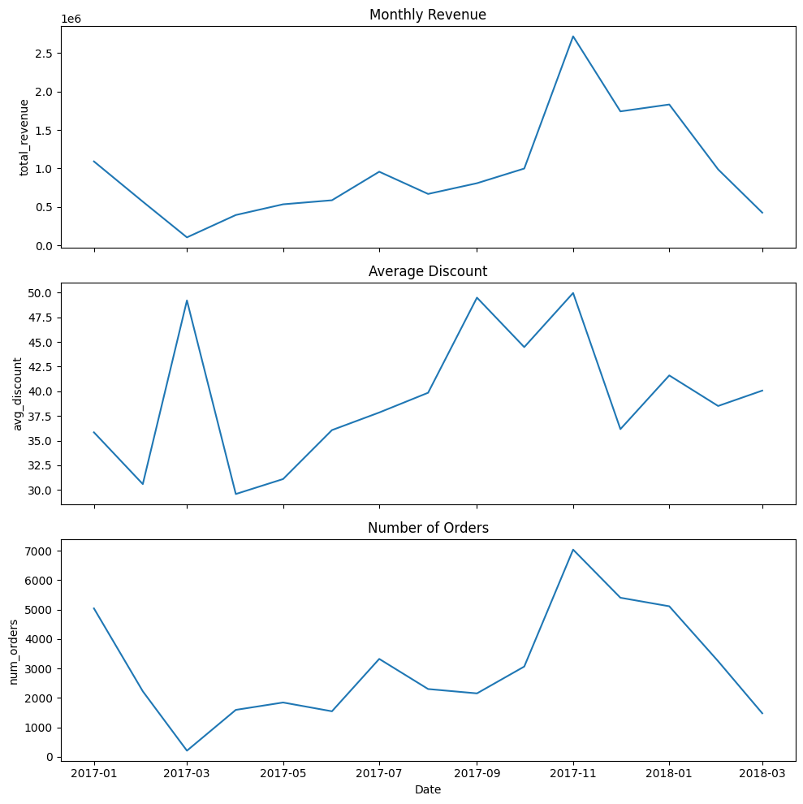
Seasonal Analysis
Spring
(February - May)
High Discounts are unfavorable

Slide 5
Seasonal Analysis
Summer
(June-September)
Moderate discounting recommended

Slide 6
Seasonal Analysis
Winter
(October-January)
Best Time for Discounts

Slide 7
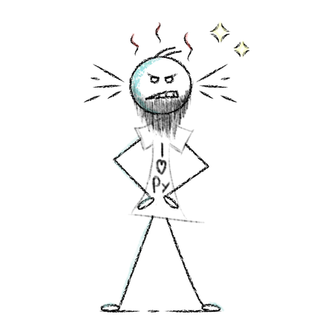
Recommendations & Next Steps
“What is wrong with these prices?!”
– Ahmed (Source: Memory)
Standardize data collection processes
Enforce a universal number format of prices
Audit product price entries regularly
Implement data integrity checks to ensure alignment between orders, orderliness and products
Flag and review outliers
Invest in ongoing data quality monitoring and cleaning pipelines

Slide 8

Thank you for your attention!

Slide 9
Appendix

Slide 10
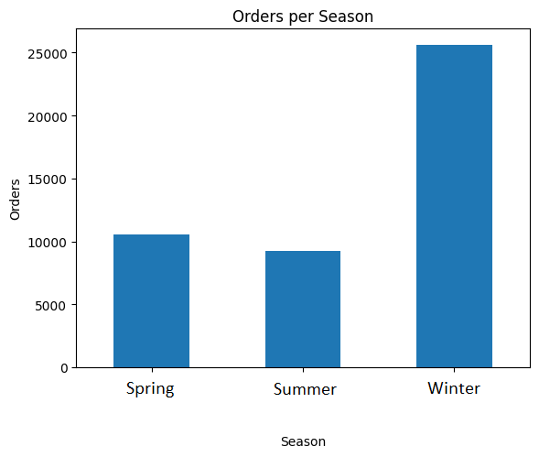
Order Differences
Spring: moderate amount in Orders
Summer: slight decrease in Orders
Winter: High in Orders
Orders

Slide 11
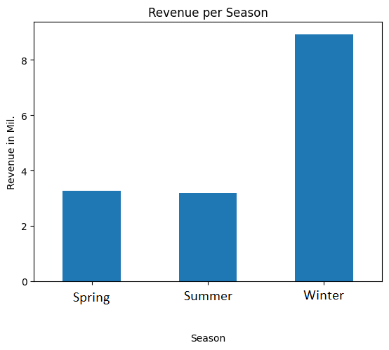
Revenue Differences
Spring: little bit more Revenue than Summer
Summer: little bit less Revenue than Spring
Winter: High Revenue

Slide 12
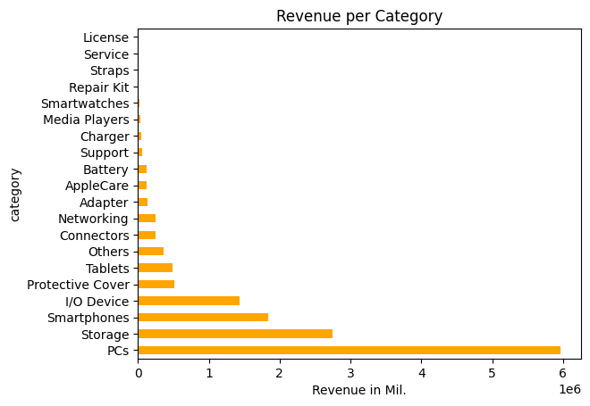
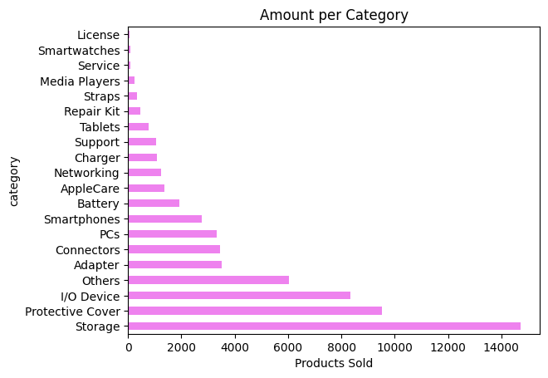
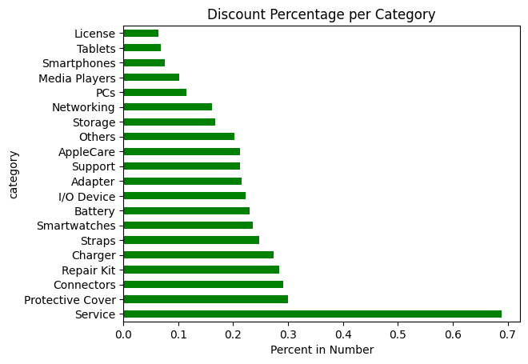
Category Insights
Best Revenue:
PCs and Storage
Most Sold:
Storage and Protective Cover
Highest Discount:
Services and Protective Cover

